Slide 1




Audible Data Cleaning
Case Study
Mayank Singh

Slide 2

PURPOSE
Utilize Power Query Editor in Excel to clean and standardize an Audible dataset. Tasks include formatting columns, ensuring data consistency, and preparing the dataset for analysis.

Slide 3
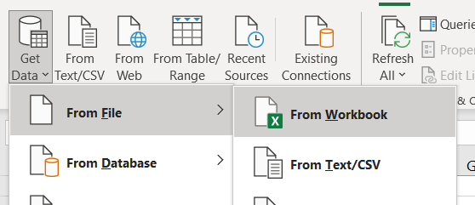

01
STANDARDIZE THE NAME COLUMN TO ENSURE CONSISTENT TITLE CASING.
Let’s start by selecting a blank workbook and then go to “Get Data” in Data tab followed by “From File” and then “From Workbook”.
Choose the file from your device
Now, click on “Transform” button .
Great Job ! The data is ready to work on in Power Query

Slide 4
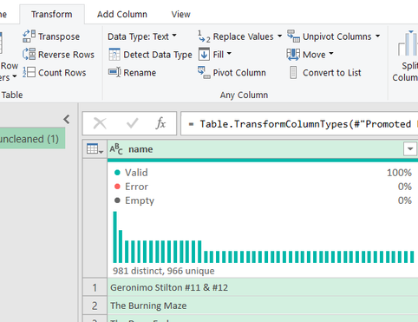
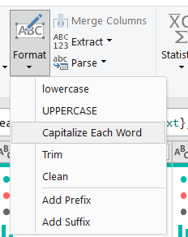
To standardize the name, select the “name “ column and go to “Transform” tab.
In “Transform” tab select “Capitalize Each Word” from “Format” option.
This will standardize the name column.
We can choose other options,lowercase and UPPERCASE, according to our requirement.

Slide 5
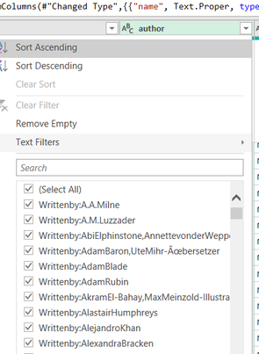
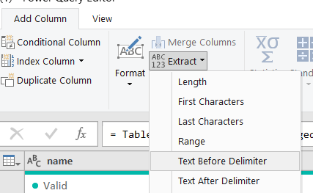
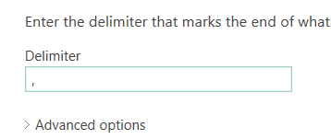
02
SEPARATE COMBINED NAMES IN THE AUTHOR COLUMN IF THERE ARE MULTIPLE AUTHORS.
Use the filtering option in “author” column to observe the pattern in which the values are stored. It is easy to conclude that cells have multiple authors separated by (,) commas. So, let’s use the same to separate name of all authors.
Starting by obtaining the first author. Go to “Add Column ”. In the “Extract” option click on “Text Before Delimiter”.
Type (,) comma in the delimiter and click on ok.

Slide 6
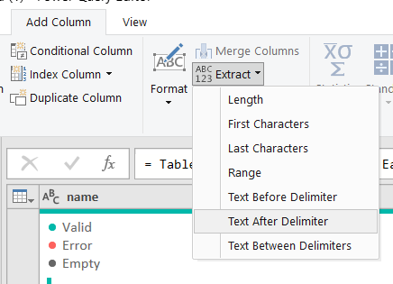
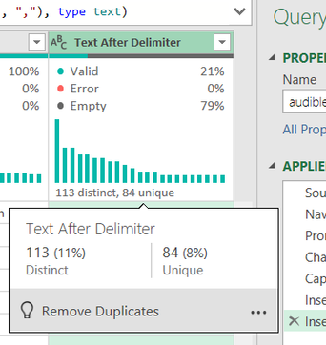

Now , let’s separate the other names using “Text After Delimiter” and use comma as delimiter. This will give the names after comma in data.
A quick check on the quality of data to ensure there are no errors also it reflects the percentage of multiple authors in our data.
Observe the values we get. One name then (,) followed by another name.

Slide 7
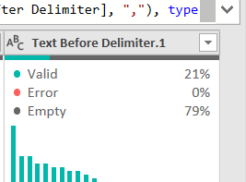

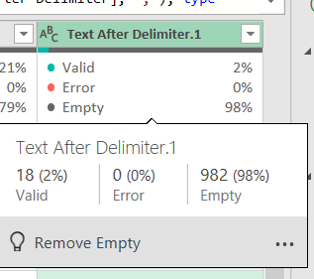
We will simply repeat the previous step of “Text Before Delimiter” to get the second name.
This will yield us another column with values before (,), which is our second author name.
To get the third author name, we’ll use “Text After Delimiter” on column we created after applying the “Text After Delimiter” for the first time.
Notice there are just 18 values

Slide 8
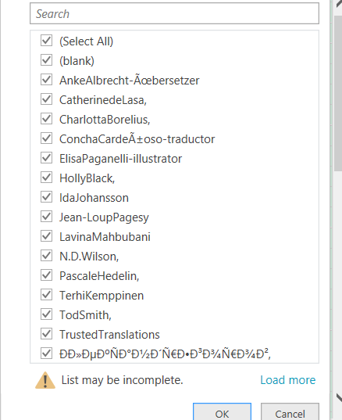
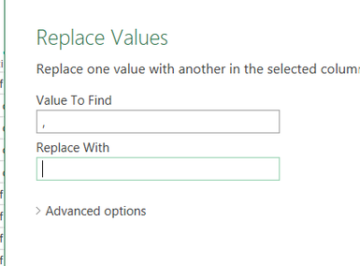

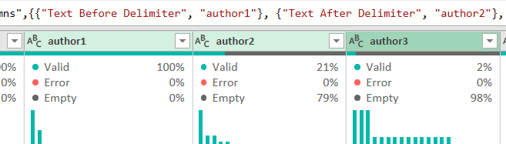
On examining the values , we can easily conclude that no fourth names exist. However there are some commas(,) at the end of values.
These commas at the end can be dealt with “Replace Value” in “Transform” tab and putting it as blank.
We can now rename the columns.

Slide 9
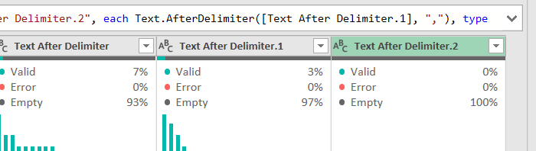
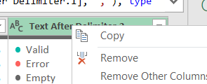
Just a quick recheck on what we concluded before, no fourth names, using “Text After Delimiter once again on last column we created .
observe that valid value is zero (0), which implies no more data in column.
Simply remove all unwanted columns before proceeding.

Slide 10
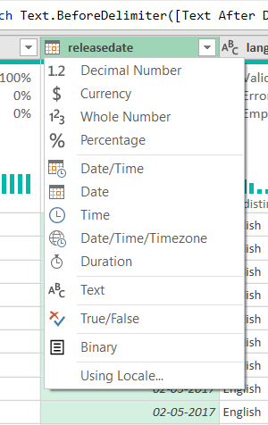
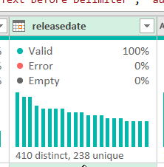
03
ENSURE ALL ENTRIES IN THE RELEASEDATE COLUMN FOLLOW A CONSISTENT DATE FORMAT (DD-MM-YYYY).
To ensure the releasedate is in right format , use the option in column to change the data type to date.
Valid = 100% implies all data is in date format with no error or empty values.

Slide 11
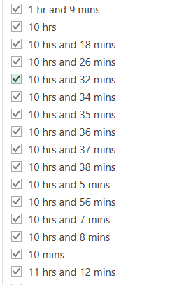
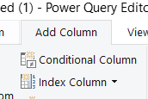
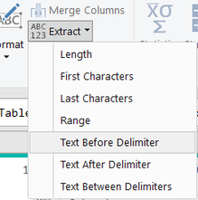
04
CONVERT THE TIME COLUMN FROM TEXT FORMAT TO A DURATION FORMAT THAT EXCEL RECOGNIZES.
Before making any actions, we’ll quickly observe the pattern in which values are stored in the column by using the drop down and scrolling through the values.
Notice the pattern
I’ll begin with extracting the hour values.
Go to ‘Add Column” select “Extract” and the choose “Text Before Delimiter” .

Slide 12
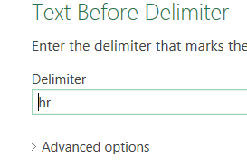
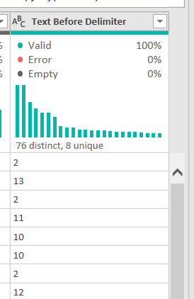
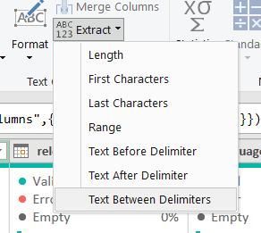
Give “hr” as the delimiter . Note- we can tackle both values , like “hr” and “hrs”, using “hr” as delimiter.
We’ll get a column like this.
Now begin with the minutes values lying between “and” and “mins”
For this , go to “Extract” in “Add Columns” and choose “Text Between Delmimter”.

Slide 13
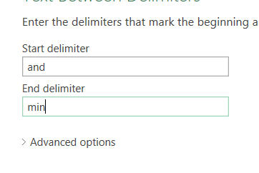
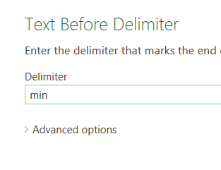
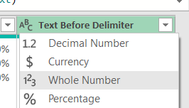
Give the values “and” and “min” in the start delimiter and end delimiter box . Note: here we have not used “mins” as using ”min” we can tackle all values that have “mins” or “min”.
For values that have no “hr” in them , like 20 mins, we can use “Text Before Delimiter” and give “min” in the delimiter box.
After the above step, convert the format to “Whole Number”. This will make the values like “20 mins” to “20” and other values , say “ 1 hr and 20 mins”, will give an error as they don’t become numbers after the step.

Slide 14

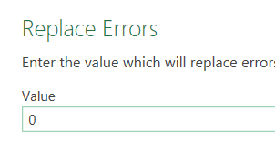
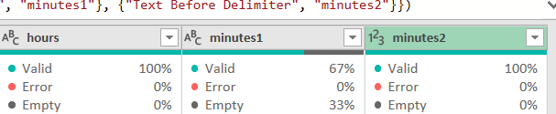
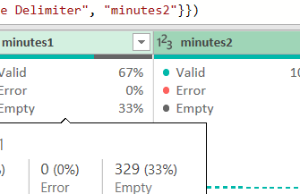
Now , right click on the column created and click on “Replace Errors”
In the dialog box, give zero(0) as value.
Rename the columns, say “hours”, “minutes1”,”minutes2".
Select the two minutes cloumns .

Slide 15
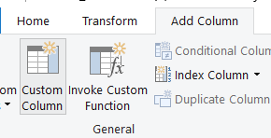
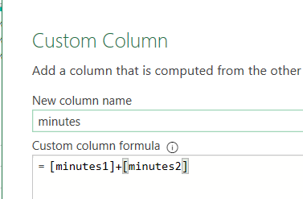
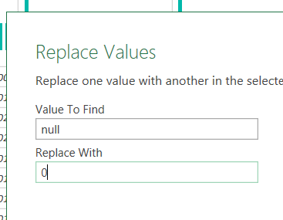
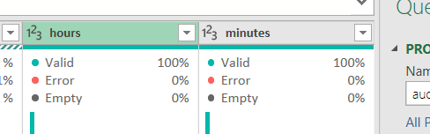
Go to “Add Column” then “Custom Column”.
Give name as “minutes” and formula as sum of the two minutes columns, minutes1+minutes2. Right on the colums created and choose “Replace Value” and replace “null” with “0”.
As a result we have a single column “minutes” with all minute values and an “hours” column.

Slide 16
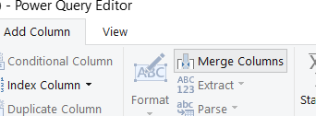
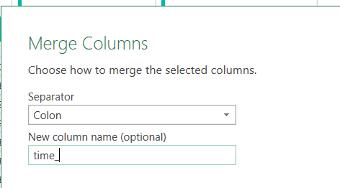

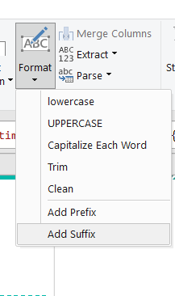
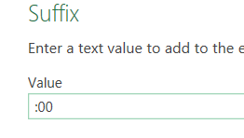
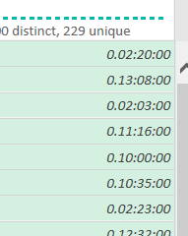
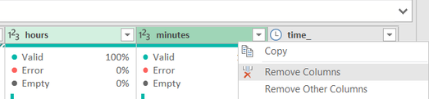

Go to “Merge Columns” in Add Column tab .
Give the separator as colon(:) and name it “time_”.
Now , to complete the date format, go to transform tab then click “Format” and then choose “Add Suffix” and give value “:00”.
Convert the format to “Duration”.
Remove the “hours” and “minutes” columns

Slide 17
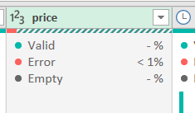
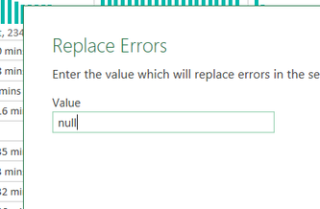
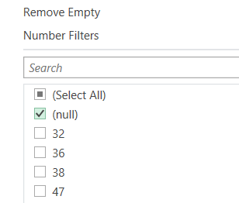
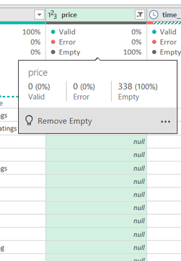
05
ENSURE THE PRICE COLUMN IS IN A NUMERIC FORMAT, AND IDENTIFY ANY NON-NUMERIC VALUES.
To ensure , we can choose “Demical Numbers” from format in column.
Secondly, right click on column and “Replace Errors” with “null”.
We can now use the drop down to filter “null” values to identify the missing values in price column.

Slide 18
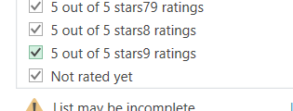
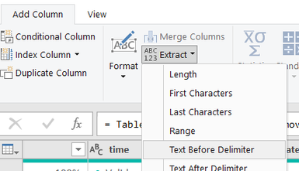
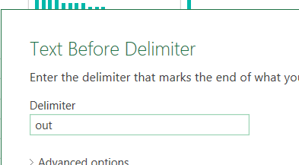
06
CONVERT TEXT RATINGS IN THE STARS COLUMN TO NUMERIC VALUES.
Let’s begin with understanding how the values are in the “ratings” column. Using drop down and scrolling through the values , observe the pattern “5 out of 5 stars9 ratings” and “Not rated yet” . Values mostly comply with this pattern.
Using “Text Before Delimiter” in “Extract” of add column to get the rating number, like 5,4 etc.
In the dialog box, give Delimiter as “out”

Slide 19

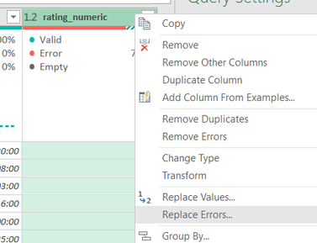
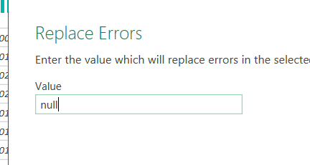
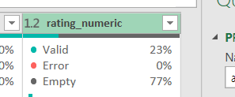
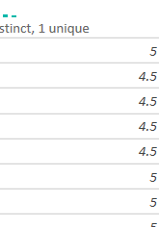
Change the format of the created column to Decimal Number. It’ll give some values as error that correspondes to “Not rated yet”.
The errors can be replaced with “null” using right click and selecting ”Replace Errors”.
Once we are done with above step, we will get the values in numeric format with non-numeric values as null.

Slide 20




07
SPLIT THE NARRATEDBY COLUMN INTO MULTIPLE COLUMNS IF MULTIPLE NARRATORS ARE LISTED.
Let’s browse through the values in narrators column. Some cells have multiple names separated by comma(,).
Go to “Extract” in Add Column choose “Text Before Delimiter and give the delimiter as “,”.
The above step will give us the first name of the narrator in each cell.

Slide 21



Use “Text After Delimiter” now to extract the values after first name, i.e, second name or third name., with comma as delimiter.
The column thus created has values separated by commas(,).
We can now use “Text Before Delimiter” with comma as delimiter to extract the second name.

Slide 22



Let’s move on to extracting the third name. This can be done by using ‘Text After Delimiter” and using comma(,) as delimiter.
We can conclude that the cells have no other name after scrolling through the values.
The same conclusion can be reached by using “Text After Delimiter” with comma(,) as delimiter. The column thus formed is empty with no valid values.
Now using “Replace Values” in Transform Tab to remove the commas(,) and the end.

Slide 23


We get values like this.
Now we can rename the columns , say “narrator1”, narrator2" and “narrator3”.

Slide 24



08
MERGE THE RELEASEDATE AND LANGUAGE COLUMNS INTO A SINGLE NEW COLUMN NAMED RELEASEINFO WITH THE FORMAT "DD-MM-YYYY, LANGUAGE."
Start with selecting both “releasedate” and “language” column.
Click on “Merge Columns” in Add Column
Select “Custom” in Separator option in Merge Columns dialog box.

Slide 25


Give “, “ as the separator and name the column as “releaseinfo”.
We get a column like this with value in the fashion “06-11-2020, English”.

Slide 26



09
ENSURE ALL CURRENCY VALUES IN THE PRICE COLUMN ARE FORMATTED CONSISTENTLY WITH TWO DECIMAL PLACES.
Click on “Currency” on the format option on the price column left side.
It will change the values to decimal number with two decimal places.

Slide 27
THANK YOU!
Awaiting Feedback
Made by- MAYANK SINGH

